Slide 1

Travel Itinerary Database
Group 6: Vandana Anand, Naisargi Jayeshbhai Dave, Wei Li, Meng Yi

Slide 2
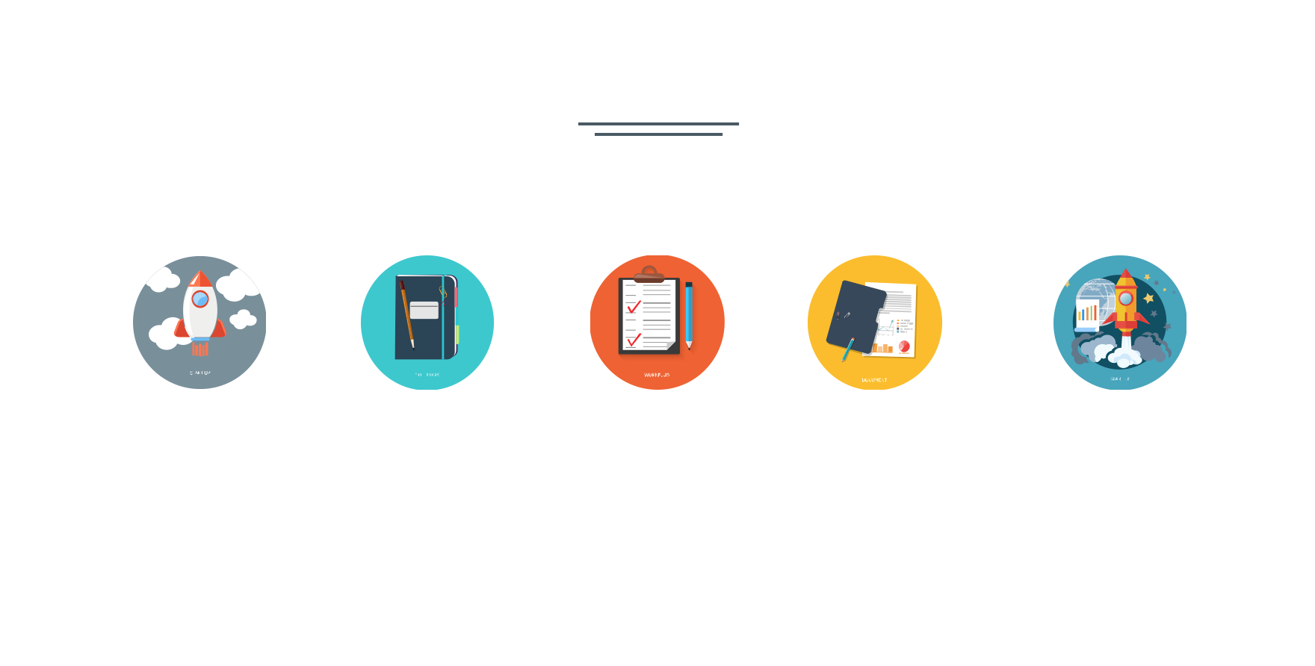
CONTENT
Problem statement
ERD
Database
Android
What we learnt

Slide 3

Problem Statement
Objective
Travel Itinerary Database
Find the most affordable travel plan
When looking at vacation trips, people tend to find the most affordable and cost efficient travel plan
Design an application that allows people to choose the best available travel plan
Select the best & available location
Calculate the price automatically

Slide 4
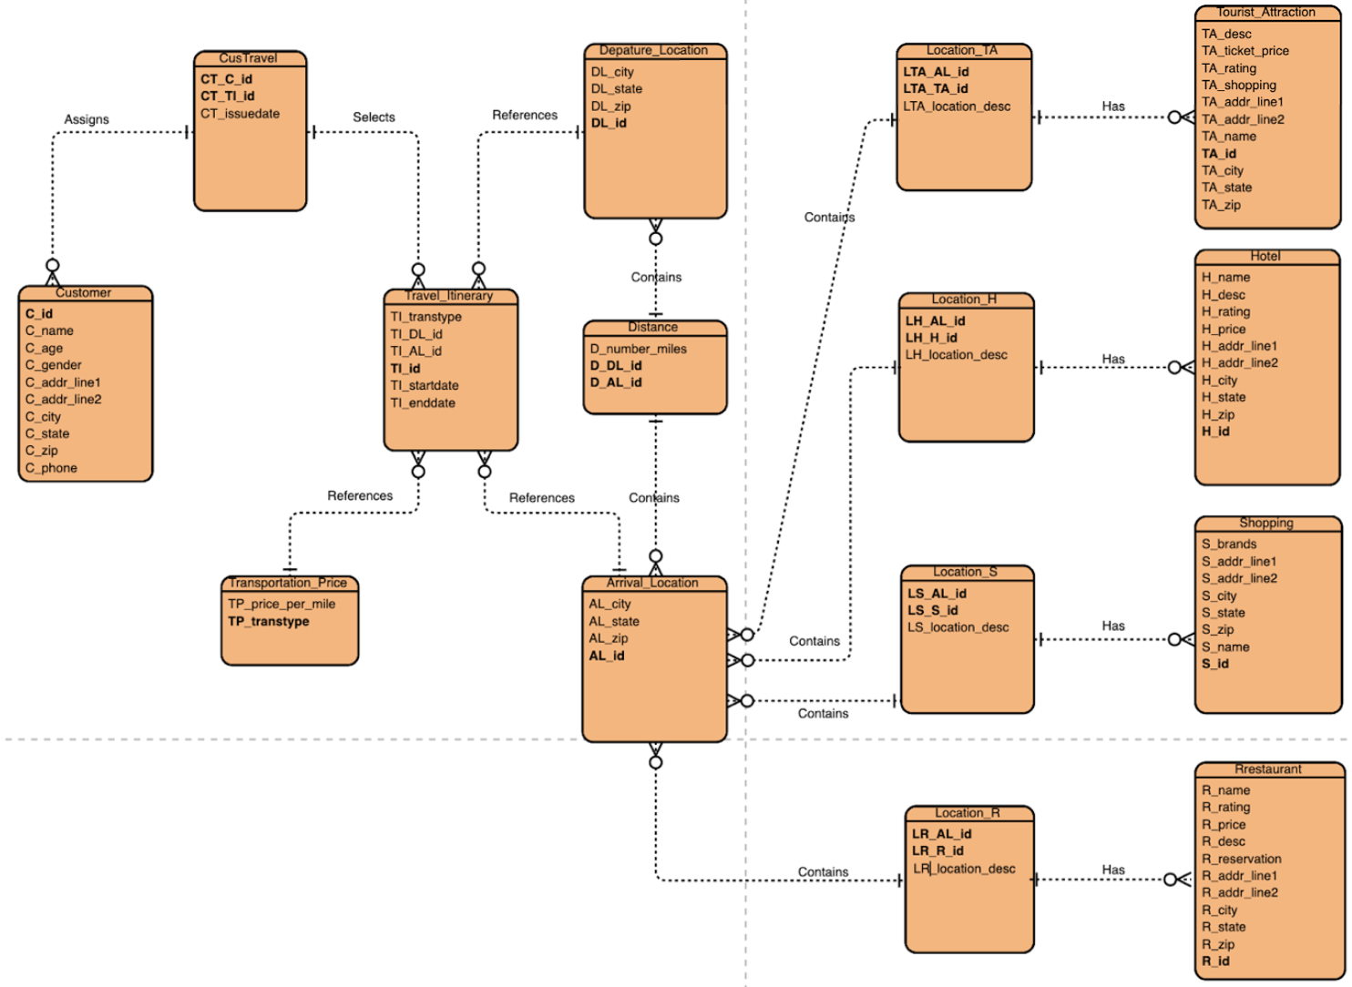
ERD
Notes:
The entire ERD is shown on the slide. It is mainly divided into two parts: one is the left part. It contains the customer information and basic information about

Slide 5

Customer Itinerary (Form)
Customer id | Customer.C_id
Customer name | Customer.C_name
Start date | Travel_Itinerary.TI_startdate
End date | Travel_Itinerary.TI_enddate
Depature location | Depature_Location.DL_city
Destination | Arrivial_Location.AL_city
Transport type | Travel_Itinerary.TI_transtype
Transport fee | Transportation_Price.TP_price_per_mile Distance.D_number_miles
Hotel name | Hotel.H_name
Hotel total price | Min(Hotel.H_price) (Travel_Itinerary.TI_enddate-Travel_Itinerary.TI_startdate)

Slide 6


Database
15 Tables, 1 View
Tables store information about the customer, hotels, restaurants, travel attractions, shopping malls, locations, distance, price.
The view is the finalized travel itinerary and is based on what the customer selects for

Slide 7

Table example
The below query shows the details of the customer with customer id ‘C003’

Slide 8
View example
The below query shows the customer itinerary for customer id ‘C003’ after the customer has selected their preference for all fields.

Slide 9


Possible improvements in Database
Avoid subqueries
Improve the indexing to facilitate faster data retrieval
Notes:
Correlated subqueries depend on values from a parent query. The inner query is run for every row processed by the outer query

Slide 10
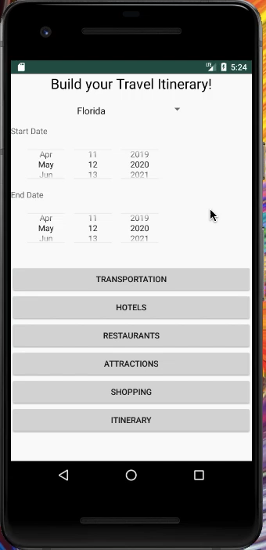

Android Application Demo

Slide 11
Database Features
Space Estimates
Backup and Security
Data Quality
Notes:
The database would need a considerable amount of space because it needs to store multiple travel itineraries of a customer. It also needs to store multiple locations as well as each location’s available transportation modes, hotels, restaurants, attractions, and shopping areas.
For any reason if the application crashes or does not function normally, the customer’s data needs to be backed up so that they would not have to rebuild their itinerary.
This would add to the storage allocated for the application and database. It could be done through external hard drives or the cloud for example.
Security would need to be provided because others should not be able to view or stalk a customer’s travel plans or data for safety reasons. Since it would lead to payment and a customer’s personal information is needed, the security feature is essential such as setting up virus protection or checking data for accuracy and authenticity.
Some data quality problems include missing, inaccurate, or redundant data. A customer could forget to fill out the end date of the trip leading to missing data. This could also lead to inaccurate information as the database can produce wrong price estimates of the travel activities. There may also be redundant data that can be filtered out. All of these problems could be reduced by having error messages in the code warning the user to input the data or prevent advancing when performing erroneous actions in the application.

Slide 12

What we learned
Apply theoretical knowledge to a practical problem
Create a database from scratch to address the travel itinerary problem
Learn android application development and integrate the database
Execute SQL queries and view in user interface

Slide 13


